Slide 1
Presentation Title | Project Presentation
Topic | University Campus Network Using Cisco Packet Tracer
Content Date | 16 August 2025
Presentation Tips | Notes are provided on many slides in this presentation to identify key speaking points and provide additional background As some of the slides are animated, this presentation is best viewed in slideshow mode

Slide 2
University Campus Network Using Cisco Packet Tracer
August 2025

Slide 3


Contents
Introduction
1
6
Block Diagram
Objectives
2
7
Main Campus Topology
Scope of the Project
3
8
Campus/Cs Topology
Requirements
4
9
Results
Tasks
5
Notes:
We’ll begin with brief introduction of the project.
Then we’ll talk about the scope of the project.
Additional

Slide 4
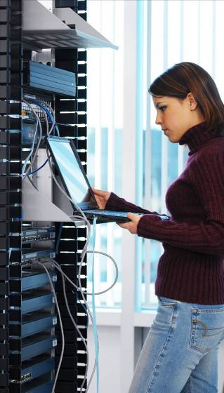

Introduction
Subtitle: Size 24, Left Aligned
Universities depend on the proper functioning and analysis of their networks for education, administration, communication, e-library, automation, etc.
An efficient network is essential to facilitate the systematic & cost-efficient transfer of information in an organization in the form of messages, files, and resources.
The project provides insights into various concepts such as topology design, IP address configuration, and how to send information in the form of packets to the wire networks of different areas of a University.

Slide 5
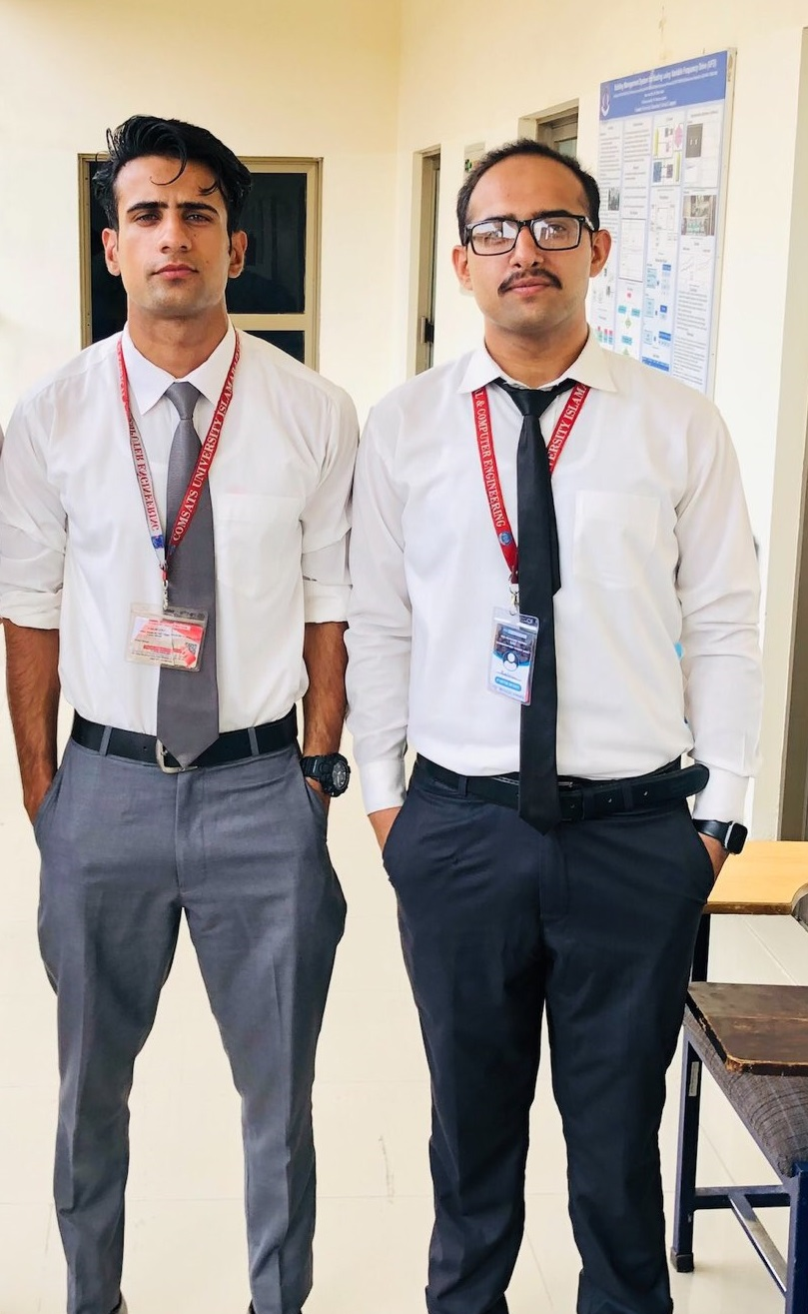
Introduction
Subtitle: Size 24, Left Aligned
We have developed a campus network for sending and receiving information.
We created a topology for a campus of multi networks and virtual local area networks (VLANs) using cisco packet tracer.
Notes:
virtual local area networks (VLANs) :
A virtual LAN (VLAN) is a logical overlay network that groups together a subset of devices that share a physical LAN, isolating the traffic for each group. A LAN is a group of computers or other devices in the same place -- e.g., the same building or campus -- that share the same physical network.
Difference between LAN and VLAN?
LAN stands for Local Area Network is a group of network devices which allow the communication between connected devices. On the other hand VLAN stands for Virtual Local Area Network which is used to enhance the performance of LANs (Local Area Networks).

Slide 6
Objectives
To get familiar with:
How to establish network for any company.
How to design a topology for any network.
Basic knowledge of networking.
Basic knowledge of Cisco Packet Tracer
Simulate the network using Cisco Packet Tracer,
Hands-on labs with real equipment
Balance of theory and practical application of skills

Slide 7

Scope: Networking Job Demand Estimated to Grow ~3M in 2012
0.5M
0.7M
0.2M
0.12M
1.1M
0.08M
0.2M
0.08M
Right Experts—Right Place—Right Time
Source: IDC White Papers on Networking Skills Gaps for – Europe (Sep 2005), Middle East and Pakistan (May 2006),
APAC (Nov 2006), Israel (May 2006), South Africa (May 2006); Bain Analysis
Notes:
In fact, according to a series of studies performed by IDC, the worldwide demand for networking professionals is expected to expand by an additional 3 million people by the year 2012.
Skilled networking professionals are needed in all geographies, in a wide variety of interesting industries, to implement the infrastructure that will enable new ways of interacting and collaborating in the world economy.
Networking is going to be an attractive profession for years to come.

Slide 8
University Campus Network
Requirements
Email Server
Cloud
Building Multilayer
Switched Networks
Department of Mathematics
Includes,
Offices
Lecture Halls/
Lecture Rooms
PCs
Printer
Admission Office
Different Offices
Student Affair Office
IT Section
PCs
Printer
Department of Computer Sciences (CS)
Offices
Labs
PC
Printer
Email Web
Server
Email
Server
Department of Electrical and Computer Engineering is distributed in the building offices for the faculty, and labs. It is expected that they will share network equipment.
CCNP
CS
Department
Building
D
Admission Office
Building
B
Building
C
Maths
Department
Building
A
ECE
Department
Cisco Packet Tracer
Requirements of the Project
Notes:
NOTE:
Create a network topology with the main components to support the following:
1. Building A: Department of Electrical and Computer Engineering is distributed in the building offices for the faculty, and labs. It is expected that
they will share networking equipment (Hint: use of VLANs is expected
here)
2. Building B: Department of Mathematics including offices, lecture halls/lecture rooms.
3. Building C: Admission office distributed in different offices.
4. There is also an email server hosted externally on the cloud.
5. Building D: Department of Computer Sciences (CS) this can acts as a
smaller campus as well as. It includes different offices and labs.
Cisco Packet Tracer — Provides a realistic simulation and visualization learning environment that supplements classroom equipment. Cisco Packet Tracer is a foundational teaching tool for CCNA Discovery, CCNA Exploration, and Packet Tracer activities are embedded in the course content. Both curricula include embedded e-doing, which applies the principle that people learn best by interacting with computer-based activities. Interactive learning promotes the exploration of networking concepts and experimentation with tools such as Packet Tracer and Flash-based activities to help students develop a greater understanding of networking technologies. Packet Tracer activities are also available for CCNA Security.

Slide 9
University Campus Network
Tasks
We have done following tasks
Devices Configuration
IP Address
VLAN
Configuration
Wires Selection
Message Communication
PCs/Printers/Switches/Routers
Unique IP Addresses
Appropriate VLAN
Appropriate Wire Selection
Forwarding/Receiving
Tasks of the Projects
Notes:
You will be expected to configure the core devices and few end devices to provide end-to-end connectivity and access to the internal servers and the external
server.
1. Each department/faculty is expected to be on its own separate IP network
2. The switches should be configured with appropriate VLANs and security
settings
3. RIPv2 will be used to provide routing for the routers in the internal network and static routing for the external server
4. The devices in building A will be expected to acquire dynamic IP addresses
from a router-based DHCP server

Slide 10
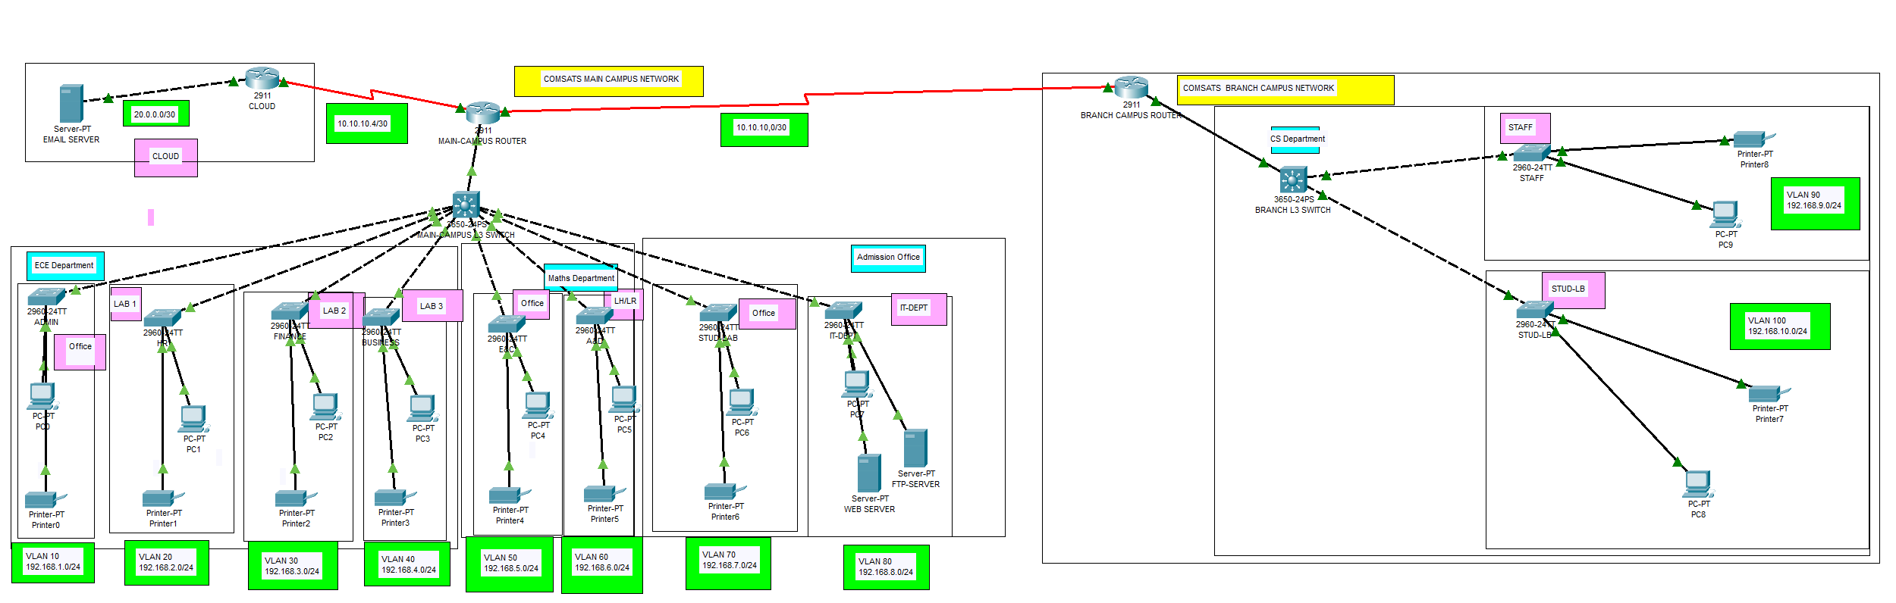
Block Diagram
Block Diagram
Figure 1.1: Block Diagram of University Network
Notes:
Let us look at the detail block diagram in Figure which illustrates the main
components involved in University Network using Cisco Packet Tracer.
In this diagram, we have used:
1. 2911 Router, for the main campus network
2. 3650-24PS Multi Layer Switch, for different departments in the buildings
3. 2960-24TT Switches, for each department
4. A cloud router,
5. Servers, email server hosted externally on cloud, and a web server for IT department
6. Host Devices, a PC and a printer
7. Wire, Serial DCE (HWIC-2T) for routers connections, Copper cross over for
switches connections, and Copper straight through for the host devices connections.

Slide 11
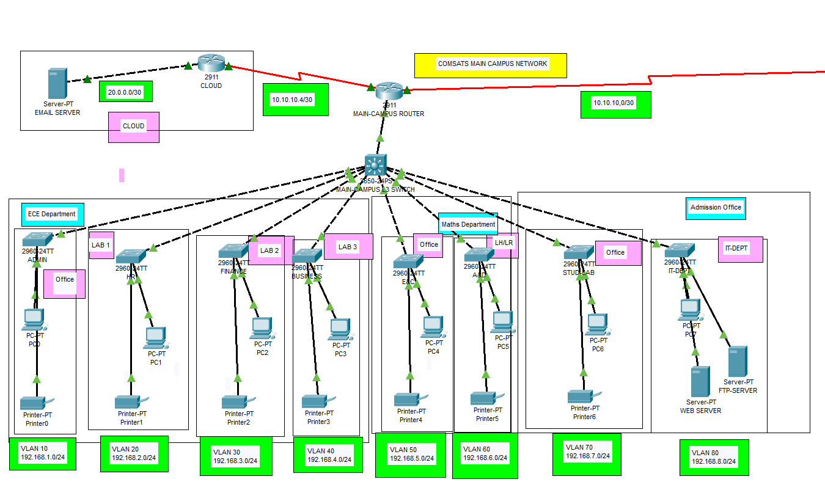
Main Campus Diagram
Figure 1.2: Main Branch Topology
Notes:
In the Fig. 1.2 a main branch topology is shown which contain three departments,
Electrical and Computer Engineering Department, Mathematics Department, Admission Department, and a Cloud Server.

Slide 12
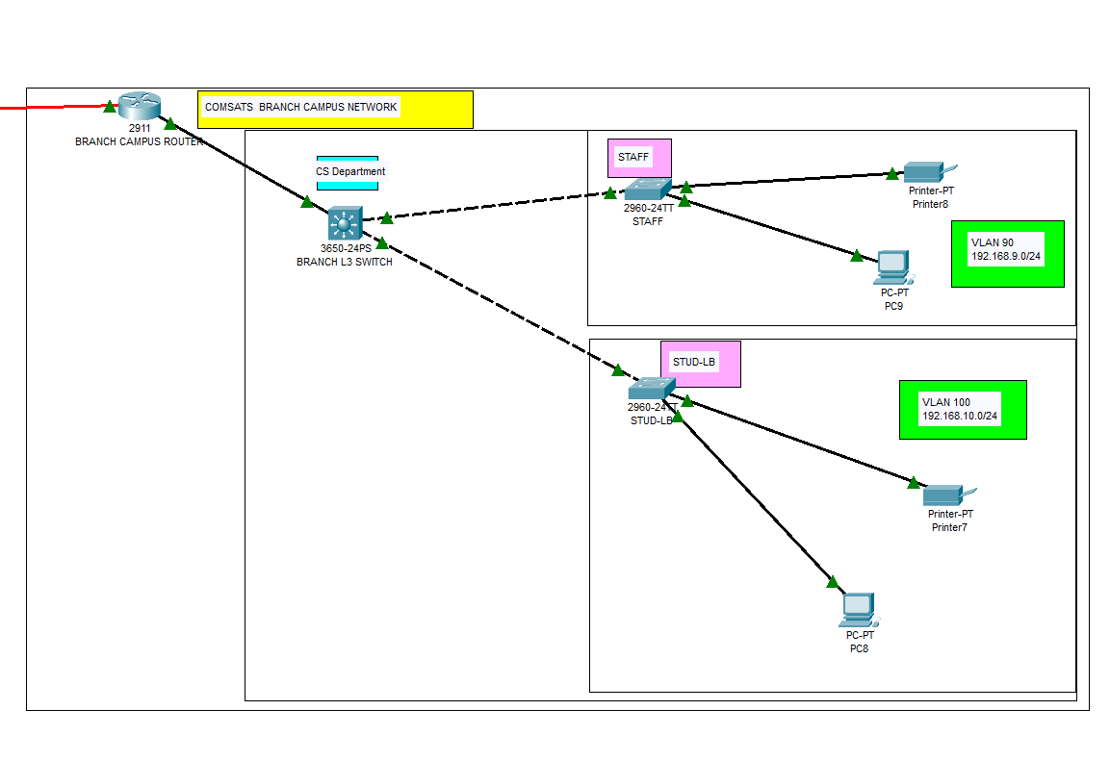
Branch/CS Department
Figure 1.3: Branch Topology of CS Department
Notes:
Whereas in Fig. 1.3, department of Computer Science is shown which contains different offices and lab. The reason we called this COMSATS Branch Campus is because it is quite apart from the other department in this case, we can consider this
as a Branch Campus. We can include this in the main branch too but the reason of treating this as a campus is to learn how to connect campus network with the main network.

Slide 13
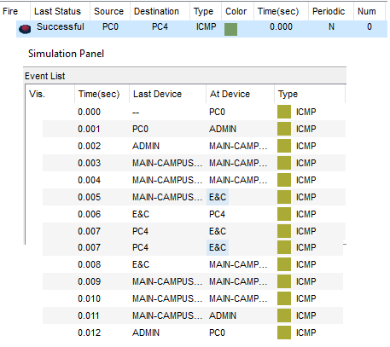
Simulation
Notes:
Fig. shows the results of the simulation. In which, we have forwarded a message
from source host i.e., PC0 to the destination host i.e., PC4.
it’s showing a complete path which it follows to reach to the destination
host and than acknowledge back to the source host with the time it take while using
Internet Control Message Protocol (ICMP) which is a network layer protocol used by
network devices to communicate.

Slide 14
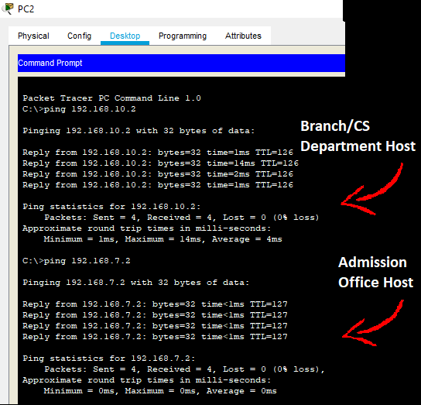
Using Command Prompt
Notes:
Fig. 4.5 shows a different way to check if our network connectivity is reliable. We have used command prompt of PC2 and have ping two hosts: one from the branch/CS Department host i.e, PC8 with IP address 192.168.10.2/24 and second from Admission
Department host’s i.e., PC6 with IP address 192.168.7.2/24.

Slide 15


This Photo by Unknown Author is licensed under CC BY

